Slide 1

呵呵
CS513 Final Project
Analysis and Classification of Singapore Airbnb Price
Group members: WEILI LIU, YI RONG

Slide 2
Introduction
The data was collected on 28 August 2019, containing nearly 8 thousand Airbnb listings in Singapore.
From KAGGLE
https://www.kaggle.com/jojoker/singapore-airbnb/tasks?taskId=122
STEVENS INSTITUTE OF TECHNOLOGY

Slide 3
Problem Description
Goal:
predict the price of Singapore Airbnb rentals based on the data provided
Find the important variables that affect price
Solution:
Clean data and normalize the data for certain algorithms.
Select data based on the algorithm requirement.
Developed machine learning models
Predict the price for the house.
Create visualization for some models.

Slide 4
Dataset Description
Dataset has 7907 rows of data with 16 columns and it is a mix between categorical and numeric values.
The columns
name, last_review and reviews_per_month
are missing some values.
Target feature is price which was divided into 3 different classes : [0,100),[100,200),[200,+)
Factors considered
room type
calculated_host_listings_count
minimum_nights
availability_365
number_of_reviews
neighbourhood_group

Slide 5

Techniques
Supervised
KNN, kknn - WEILI LIU
Decision Tree - WEILI LIU
C5.0 - WEILI LIU
Radom Forest - WEILI LIU
Naïve Bayes -YI RONG
ANN - YI RONG
Unsupervised
Hierarchical Clustering - YI RONG
k- Means Clustering - YI RONG
STEVENS INSTITUTE OF TECHNOLOGY

Slide 6
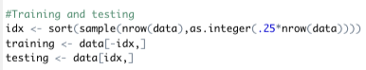
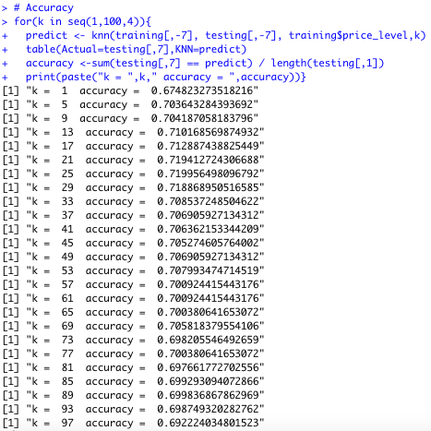
Supervised Learning KNN
Normalization :
Min - Max Normalization
Features considered:
neighborthood_group;
room type;
minimum nights;
number of reviews;
calculated host listings count;
availability_365
Training : 5930-75%
Testing: 1976 -25%
K=25 Accuracy ~ 71.99%

Slide 7
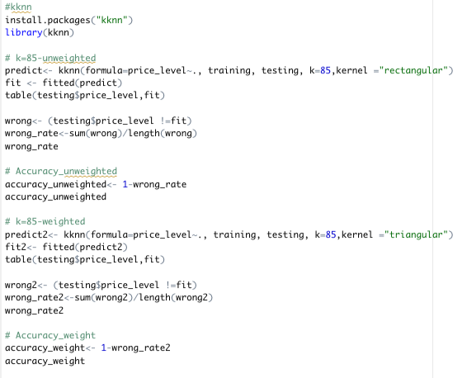
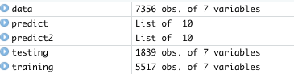
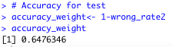
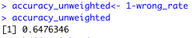
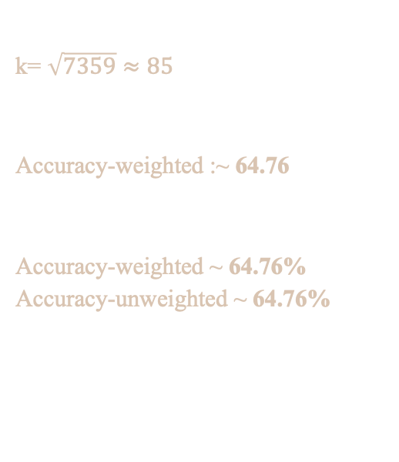
kknn
k= $\sqrt{7359}≈85$
Accuracy-weighted :~ 64.76
Accuracy-weighted ~ 64.76%
Accuracy-unweighted ~ 64.76%

Slide 8
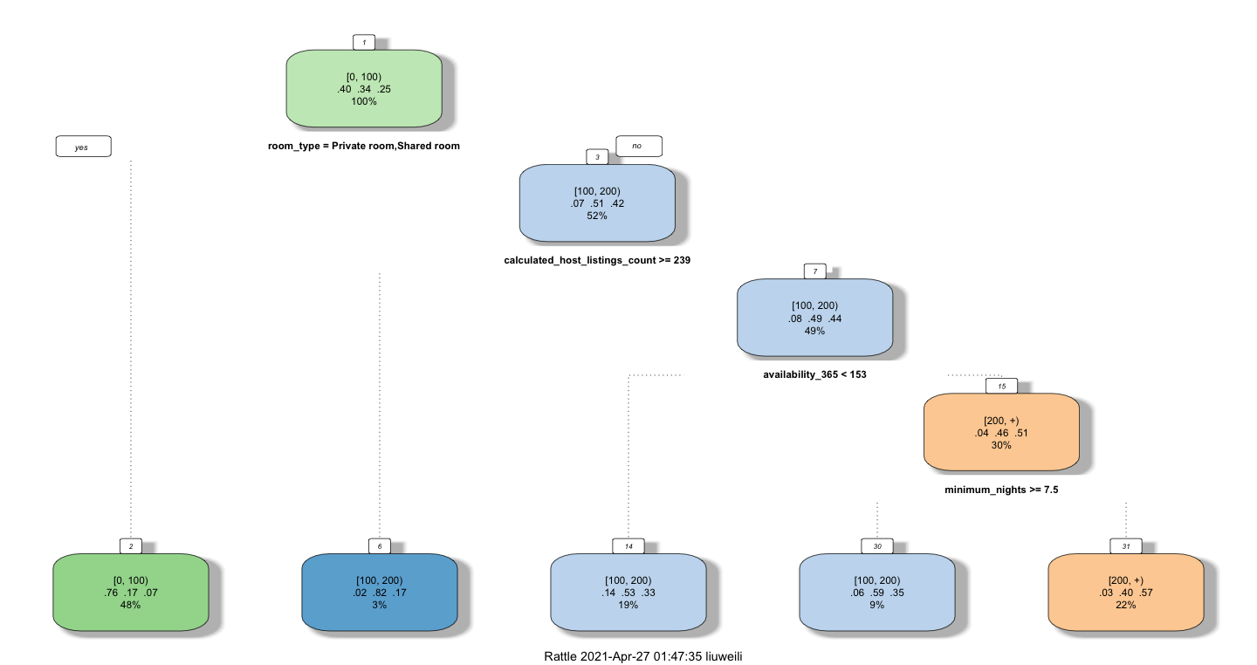
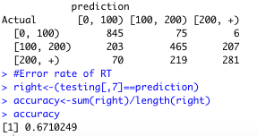
Decision Tree- CART
The dependent features:
room type
calculated_host_listings_count
minimum_nights
availability_365
Accuracy ~ 67.10%

Slide 9
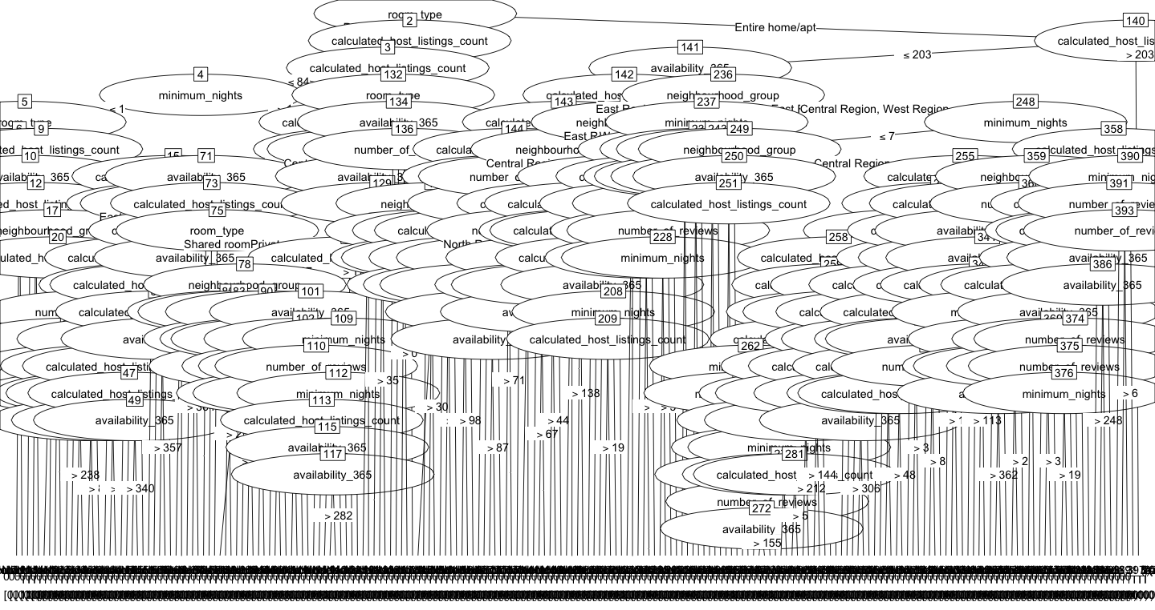
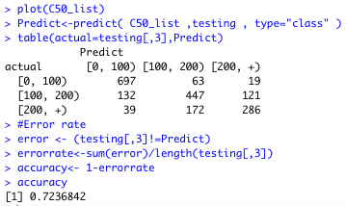
C5.0
The dependent features:
room type
neighbourhood_group
minimum_nights
number_of_reviews
calculated_host_listings_count
availability_365
Accuracy ~ 72.36%

Slide 10
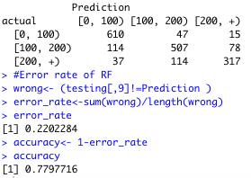
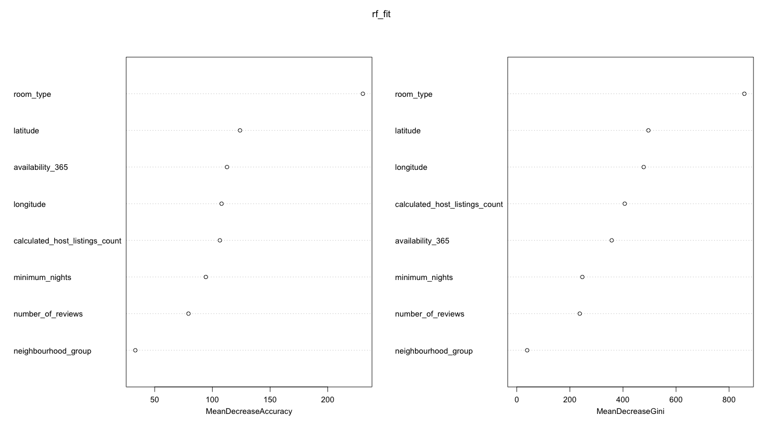
Radom Forest
The dependent features:
room type
longitude
latitude
calculated_host_listings_count
minimum_nights
availability_365
number_of_reviews
neighbourhood_group
Room type mainly affect the price
Accuracy ~ 77.97%
Radom Forest

Slide 11
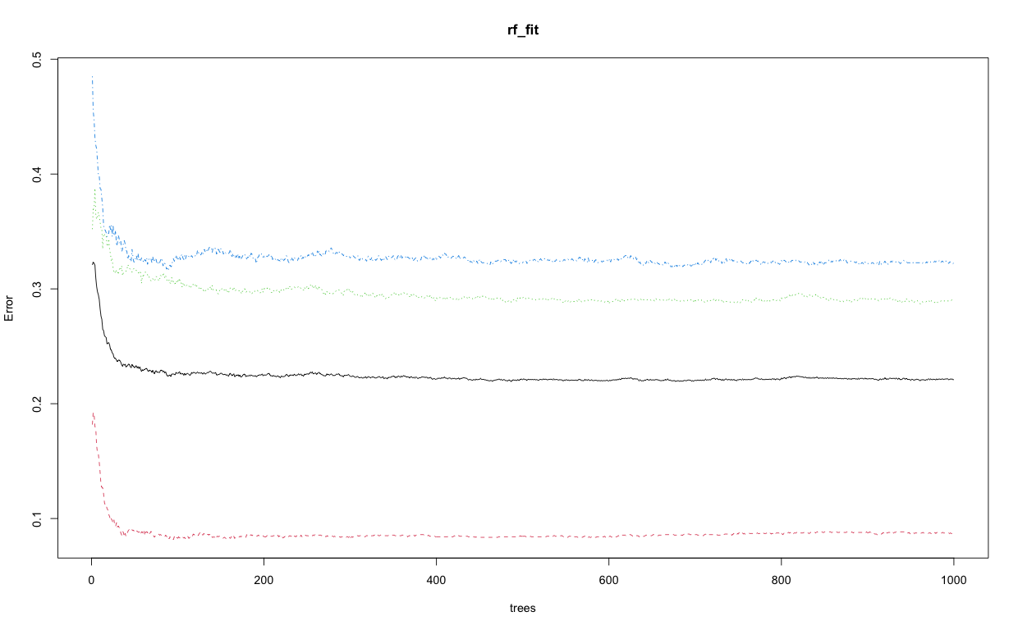
The error rates decrease when Random Forest has more trees.
Tends to be stable

Slide 12
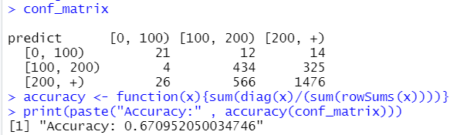
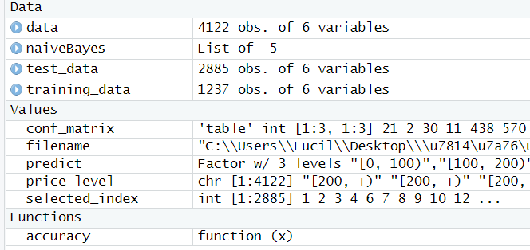
Naïve Bayes
Accuracy: ~67.1%
The dependent variable:
neighborhood group
neighborhood
latitude
longitude
room type

Slide 13
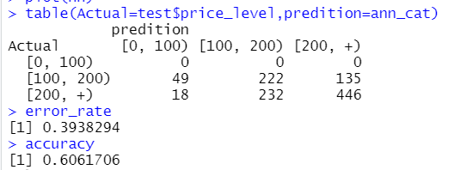
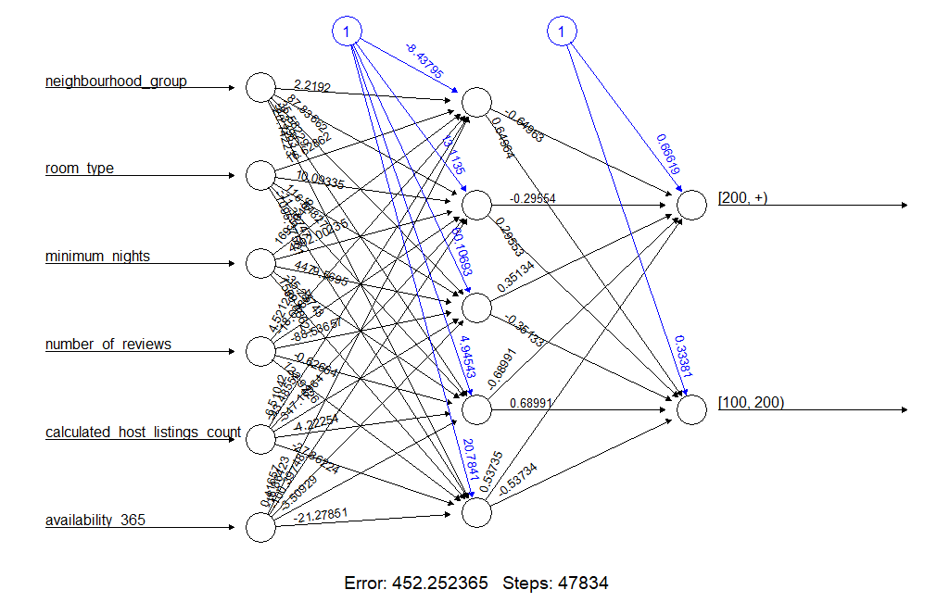
ANN
The target variable ：
Price
The dependent variable:
Neighbourthood_group
room type
minimum nights
number of reviews
calculated host listings count
availability 365
Normalization :
Min - Max Normalization
hidden：5
threshold：0.01
Accuracy: 60.62%

Slide 14
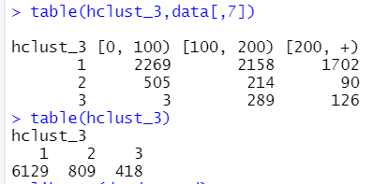
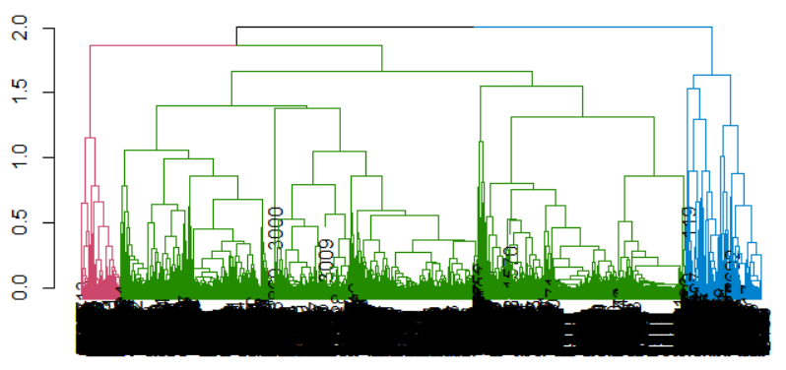
Hierarchical Clustering
The target variable ：
Price
The dependent variable:
Neighbourthood_group
room type
minimum nights
number of reviews
calculated host listings count
availability 365
Normalization :
Min - Max Normalization

Slide 15
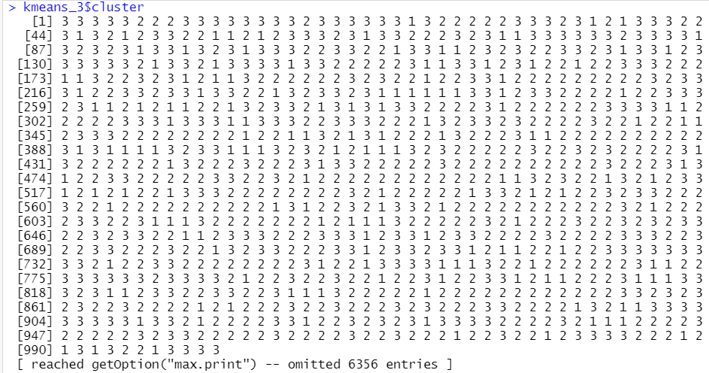
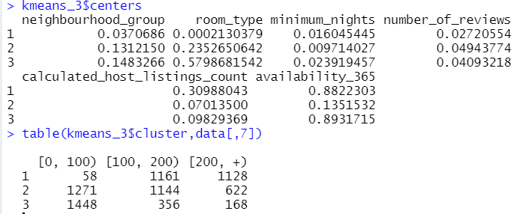
k- Means Clustering
The number of clusters, k=7
K identifies the number of centroids and then allocates every data point to the nearest cluster

Slide 16
Conclusion
Supervised learning | Accuracy
KNN | 71.99%
kknn | 64.76%
Decision Tree | 67.10%
C5.0 | 72.36%
Radom Forest | 77.97%
Naïve Bayes | 67.10%
ANN | 60.62%
Good data mining models are based on the correlation and the quantity of the dataset, low relevant features and small dataset will influence the attrition and decrease the accuracy.
In our model, neighborhood group and room type are the two main factors leading to different rental prices.
The different results of the same dataset using different models may be very large. Should choose a suitable model based on the accuracy value.
STEVENS INSTITUTE OF TECHNOLOGY

Slide 17
Future Work
Try more different Algorithms on our data, analyze the difference between supervised learning and unsupervised learning.
Using ensemble model to break down complex structure into critical features.
Collect more data and more attribute of the house to train the model to increase accuracy.
Try to match suitable house according to tenants' various requirements for house.

Slide 18
Reference
Data Source:https://www.kaggle.com/jojoker/singapore-airbnb/tasks?taskId=122
End
Thank you
STEVENS INSTITUTE OF TECHNOLOGY

